Slide 1
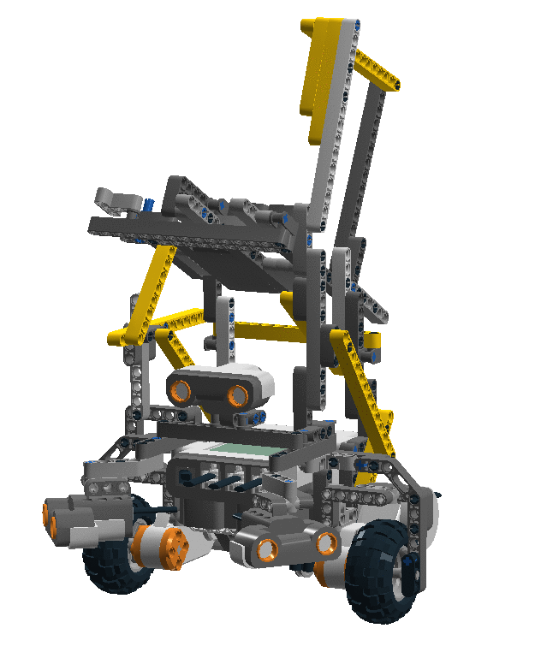
Group 05 Week 6
Hardware Model: 4.0

Slide 2
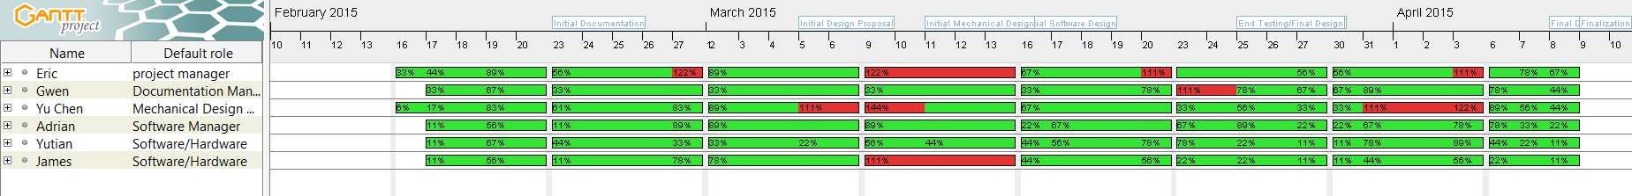
Gantt Chart & Resources charts debugged

Slide 3
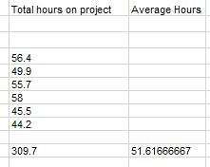
Budget

Slide 4
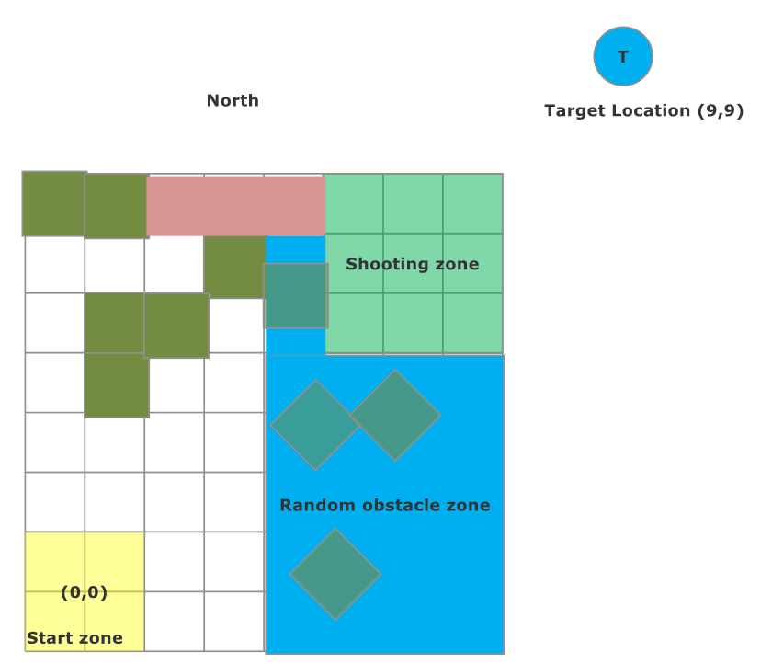
Beta Demo – Success!
Safe Localization 47s
Improved Localization
Post-Beta : 15-20s
Travel to Shooting Area: 42s
Target: 2/3 projectiles
Whole Circuit: 2:20

Slide 5
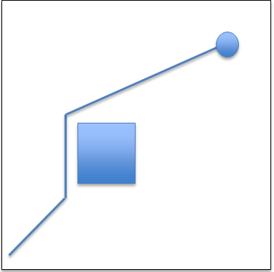
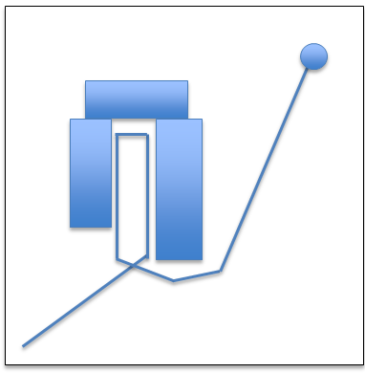
Obstacle Avoidance

Slide 6
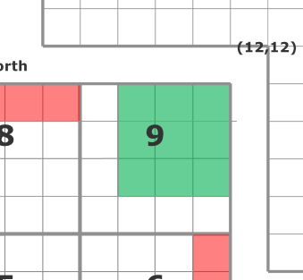
Effect on the final Competition
Error is proportional to distance travelled during avoidance
Error = 9cm for (0,0) -> (9,5) Competition: (0,0)->(9,9) -> Error roughly 15cm
Error tolerable of ~30cm radius
Run | Normal Case (error) | Extreme Case 1 (error) | Extreme Case 2 (error)
1 | Pass 3cm | Pass 3cm | Pass 7cm
2 | Pass 2cm | Pass 3cm | Pass 9cm
3 | Pass 3cm | Pass 4cm | Pass 6cm
4 | Pass 3cm | Pass 6cm | Pass 7cm
5 | Pass 3cm | Pass 3cm | Pass 8cm
6 | Pass 3cm | Pass 2cm | Pass 7cm
7 | Pass 4cm | Pass 3cm | Pass 12cm
8 | Pass 3cm | Pass 3cm | Pass 9cm
9 | Pass 4cm | Pass 3cm | Pass 9cm
10 | Pass 3cm | Pass 4cm | Pass 9cm

Slide 7
Why is the Odometer Correction Taken Off?
Does not correct the heading angle theta
Over time the correction mode is going to lose the accuracy
Solution: use localization as a replacement to fix the coordinates when needed

Slide 8
Launcher update
We can adjust the distance.

